Slide 1

InstaTalk
Human-Center Computing A.A. 2020/21
Group RAH: Hooshayr Hosna, Lima Rachel, Lorefice Alessandra

Slide 2
Index
Initial Problem
Prototyping
Evaluation
Conclusions

Slide 3
Index
Initial Problem
Prototyping
Evaluation
Conclusions

Slide 4
Initial Problem
Tandem Project is proposed by unibz so students can find partners to practice speaking. However, some of us found the following problems:
Finding suitable partner
Fixing a time with potential partners

Slide 5

Our Solution
Develop a platform that can make easier the process of finding a partner to practice languages with, especially in this pandemic situation, when partners cannot be found in presence.

Slide 6

Data collection
In addition to Tandem Project, similar websites and applications were studied.
Methods of data collection:
Desk research
Interview
Questionnaire

Slide 7
Main Results: Issues
Matching
Suitable partners (level, interests, …)
Fixing schedule
Professionalism
“Tinder risk”
Lack of seriousness

Slide 8
Index
Initial Problem
Prototyping
Evaluation
Conclusions

Slide 9
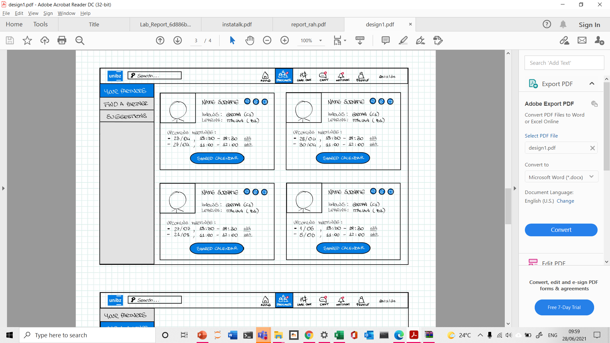
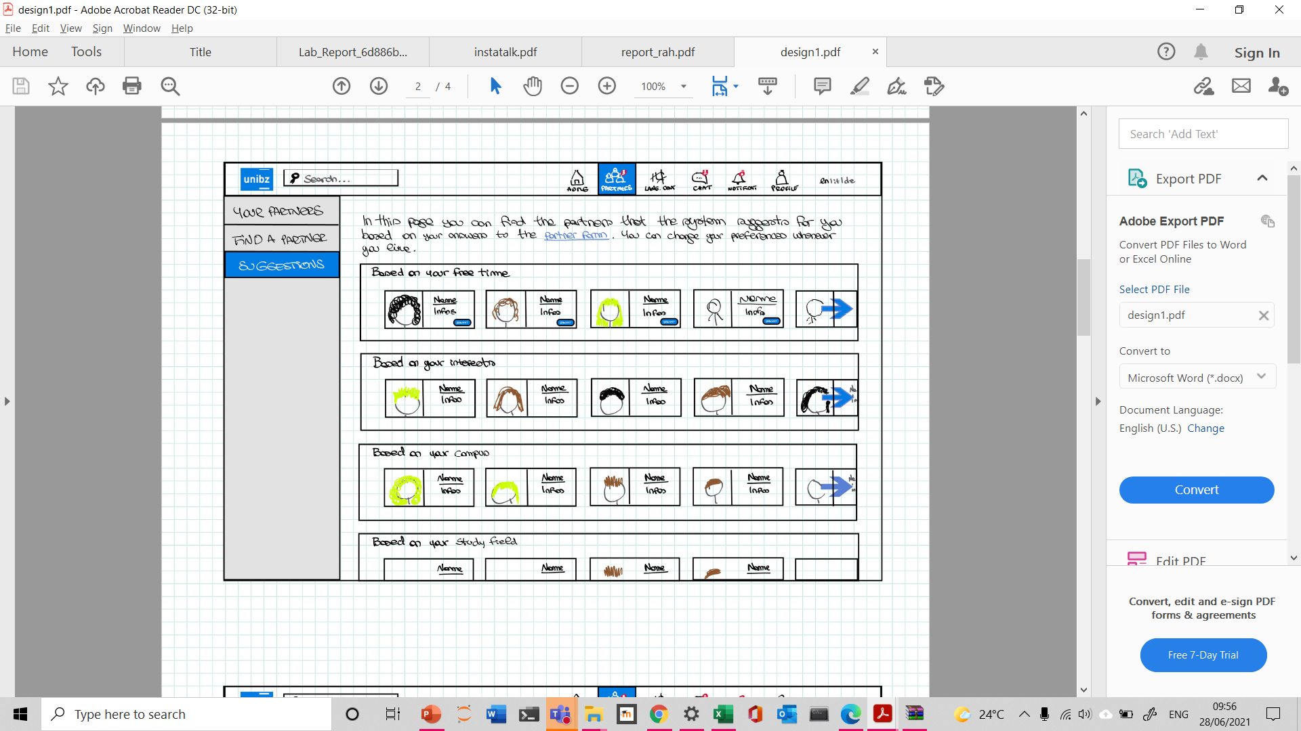
Sketches
Brainstorming sessions
Drawings with ideas of prototyping for the main views of the platform
Final sketches
How functionalities should appear on the website

Slide 10
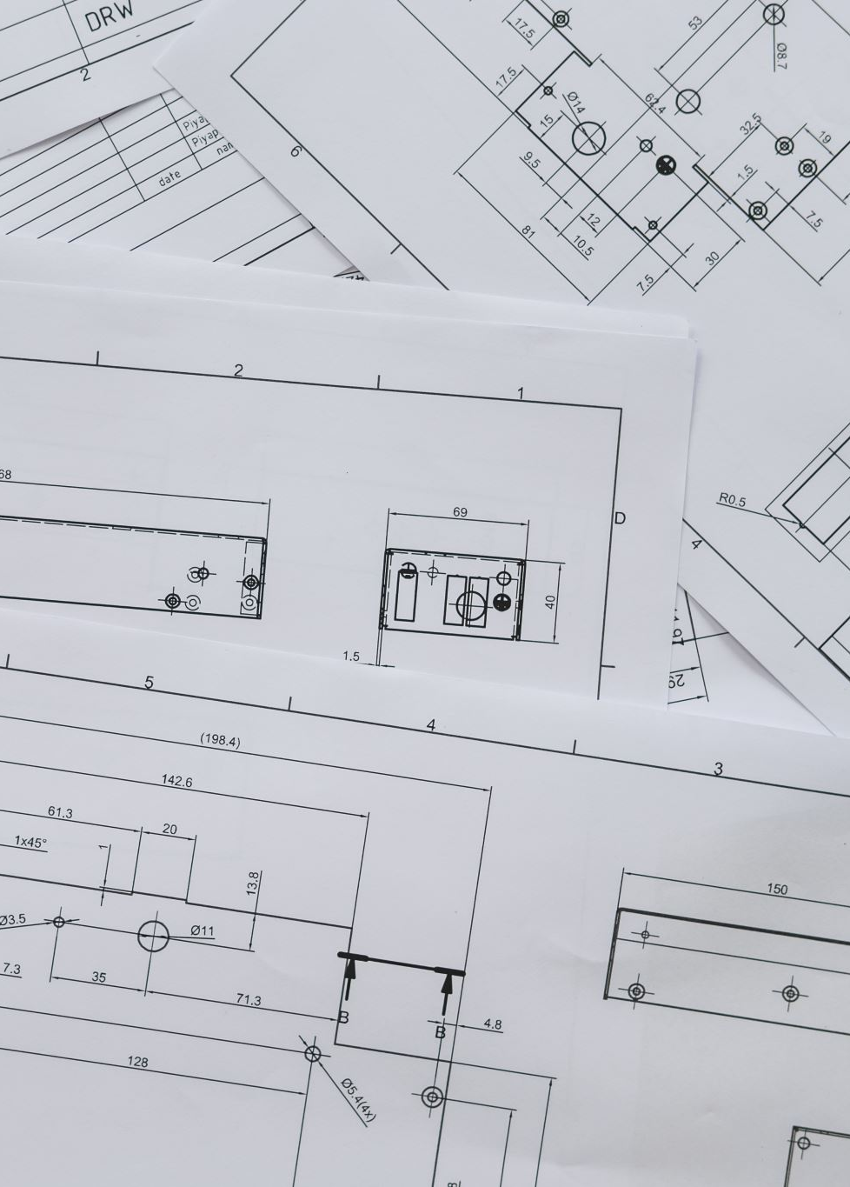
Figma Prototype
• Size and appearance of the items according to their importance
• Mix of different colors and contrasts
• Icons and symbols based on mental models
• Flat design

Slide 11
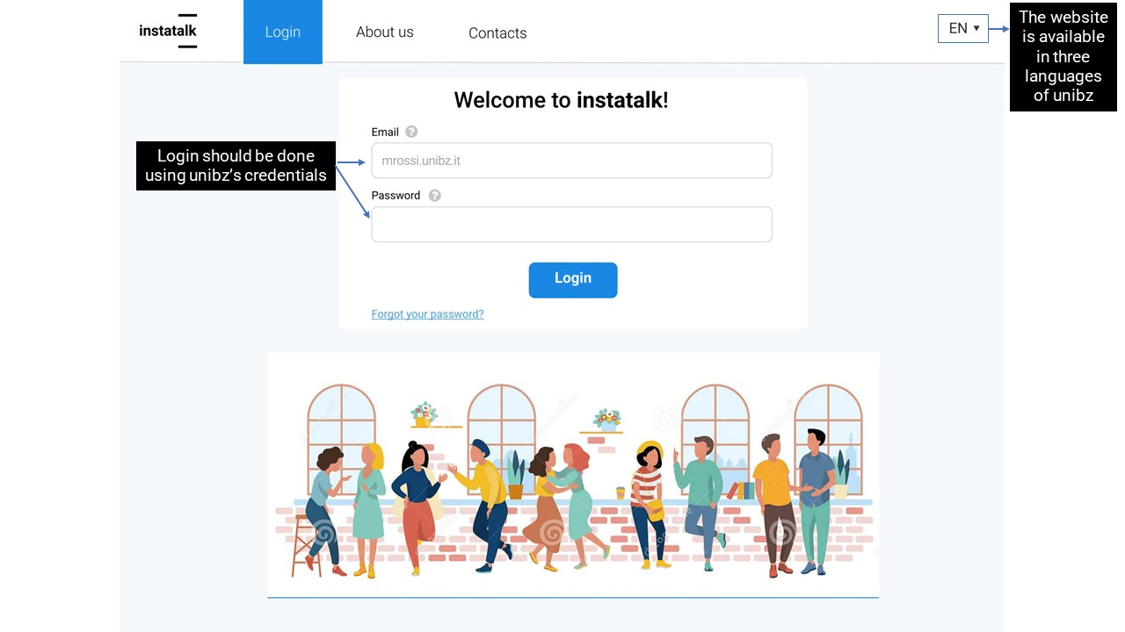

Slide 12
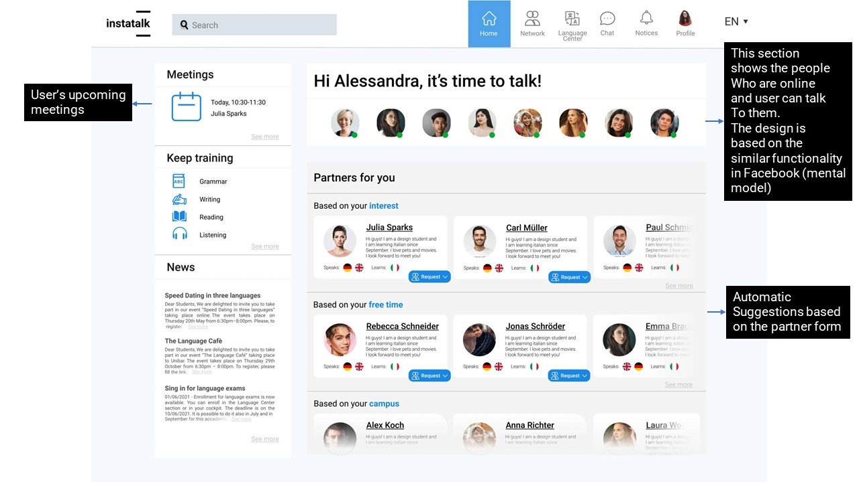

Slide 13
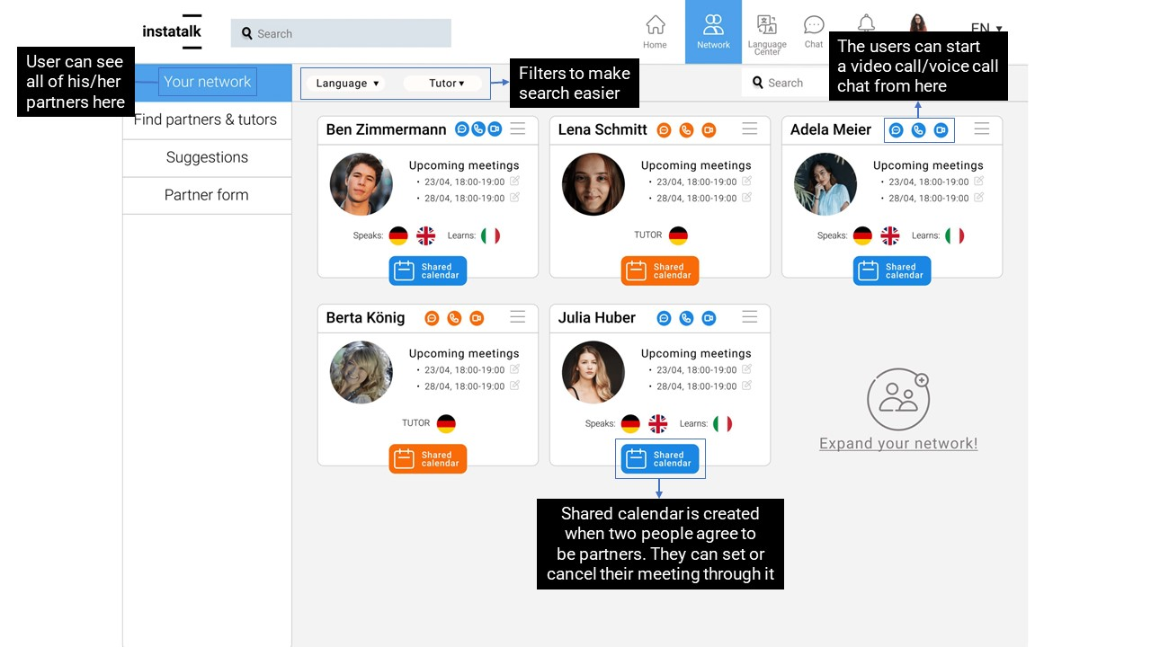

Slide 14
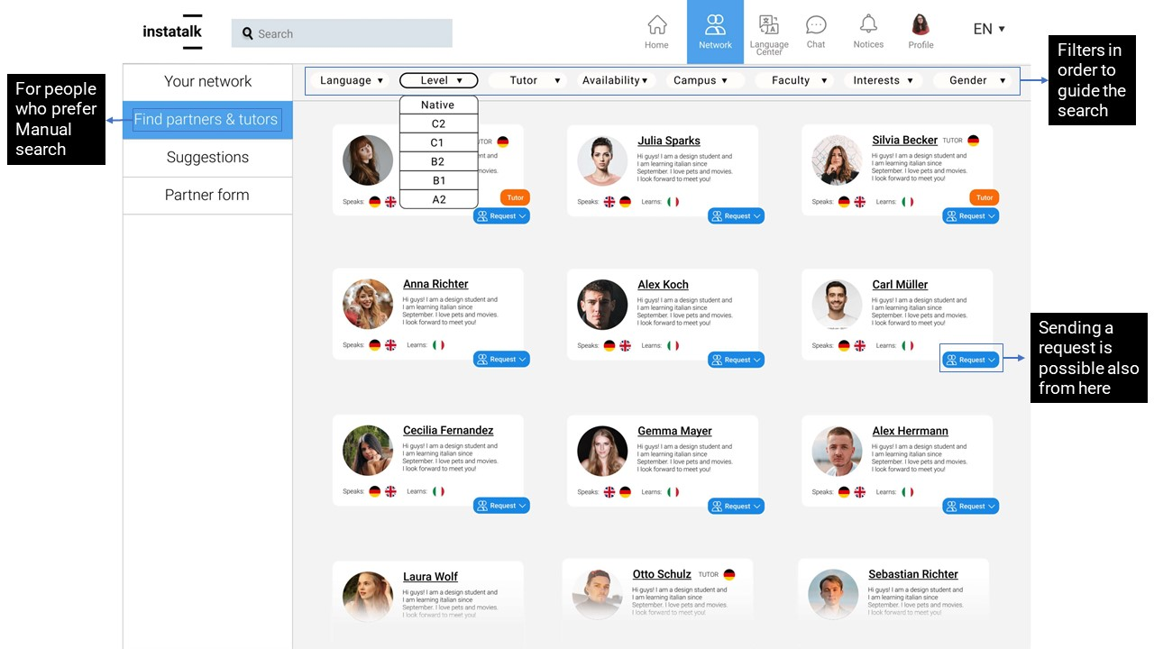

Slide 15
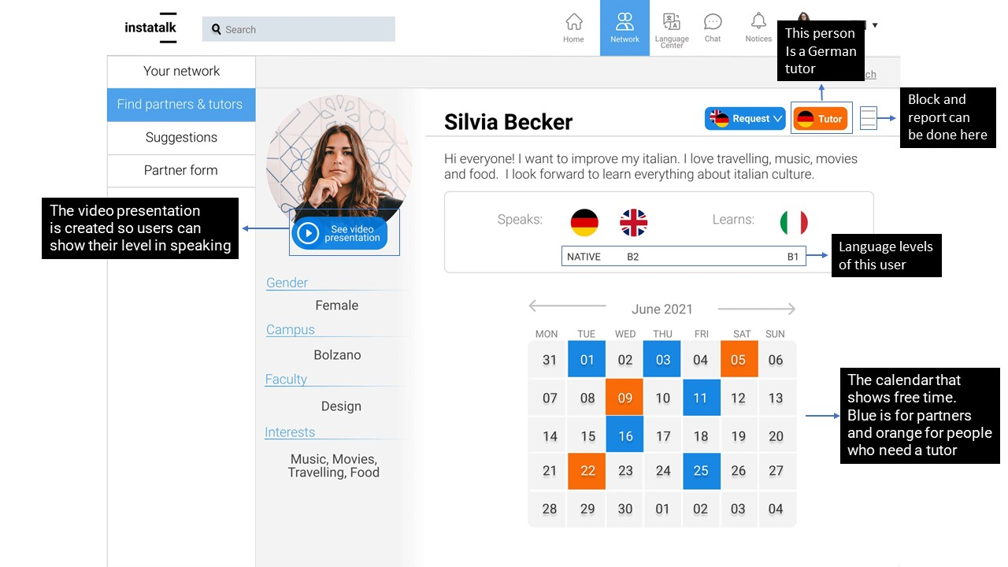

Slide 16
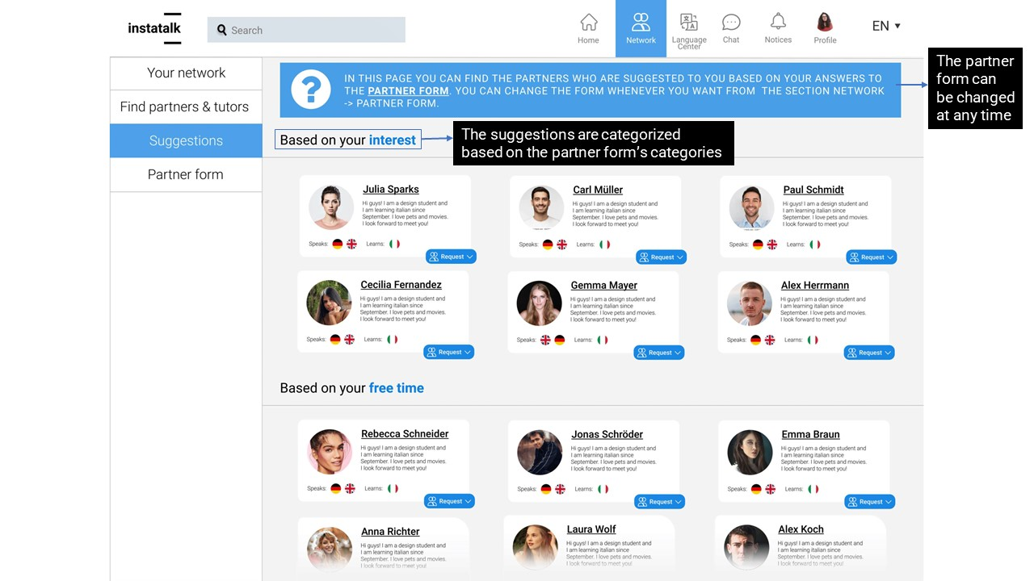

Slide 17
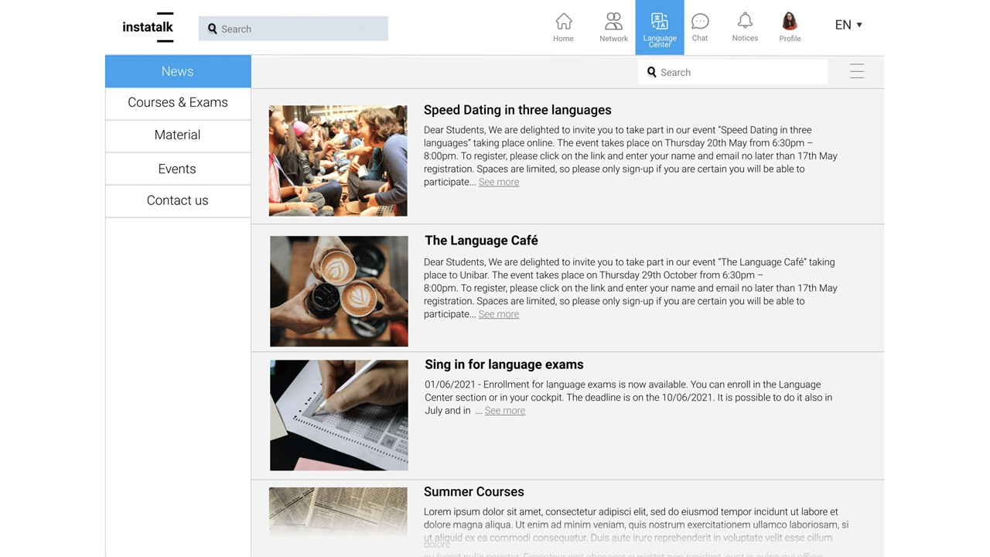

Slide 18
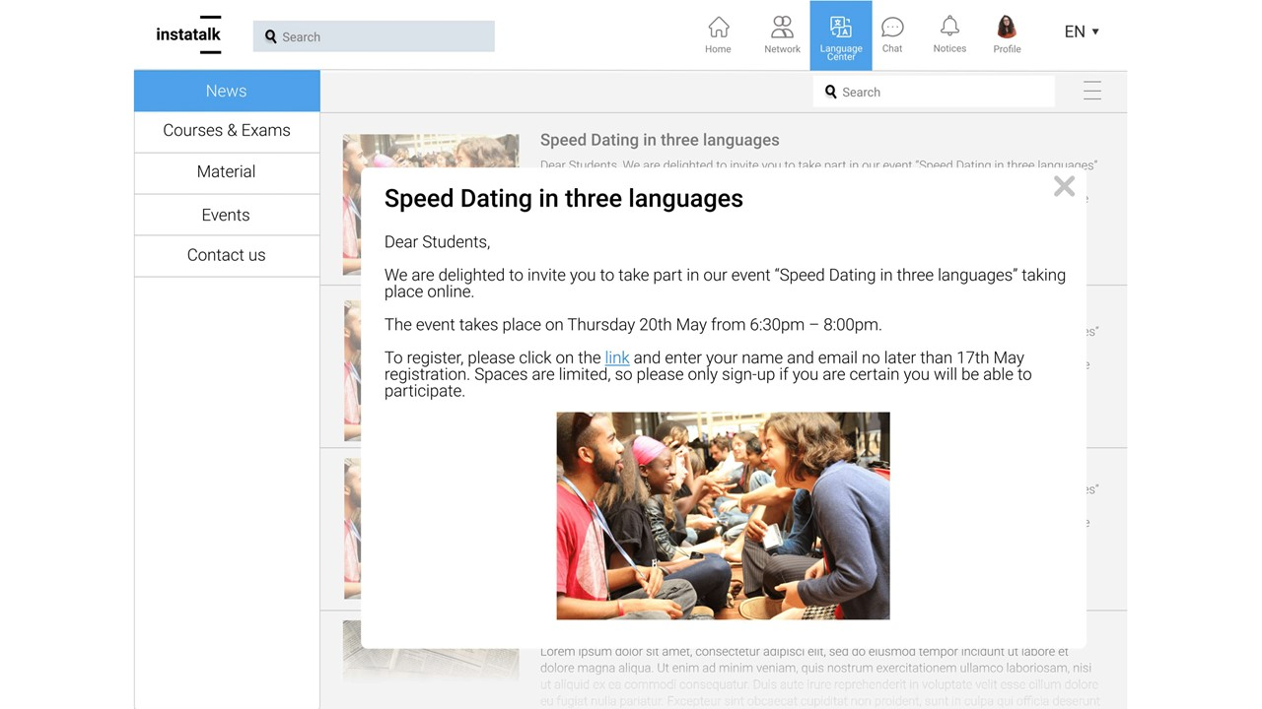

Slide 19
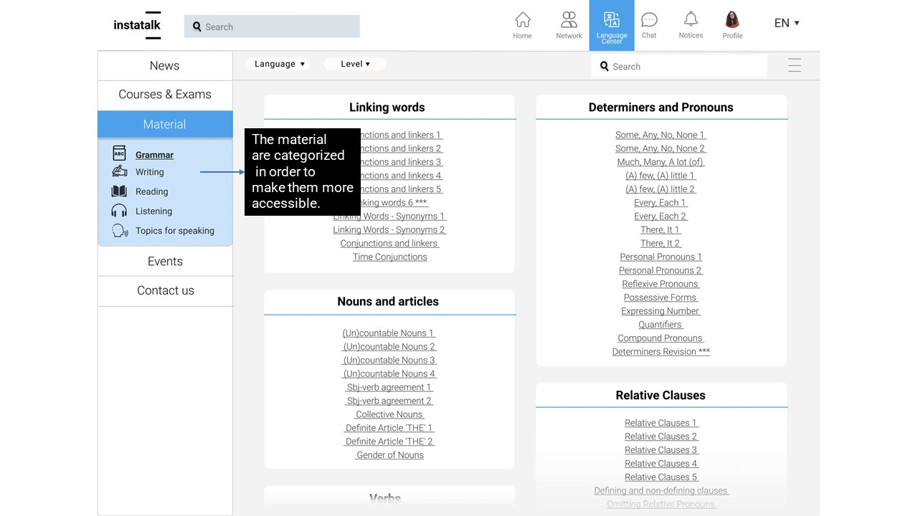

Slide 20
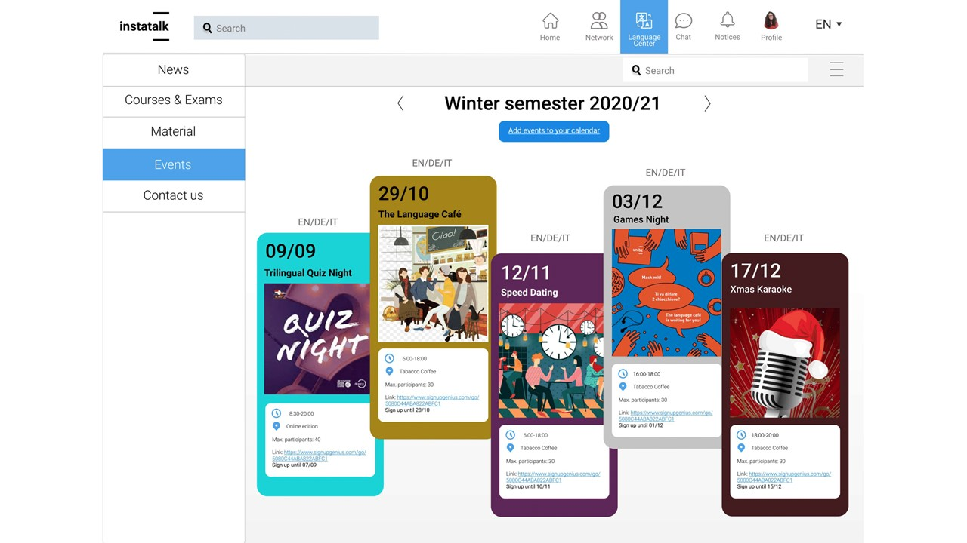

Slide 21
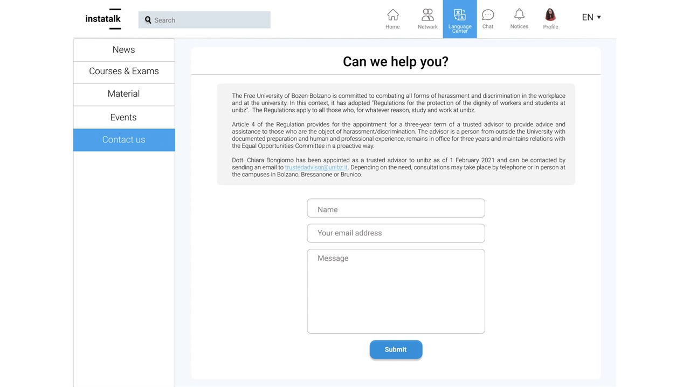

Slide 22
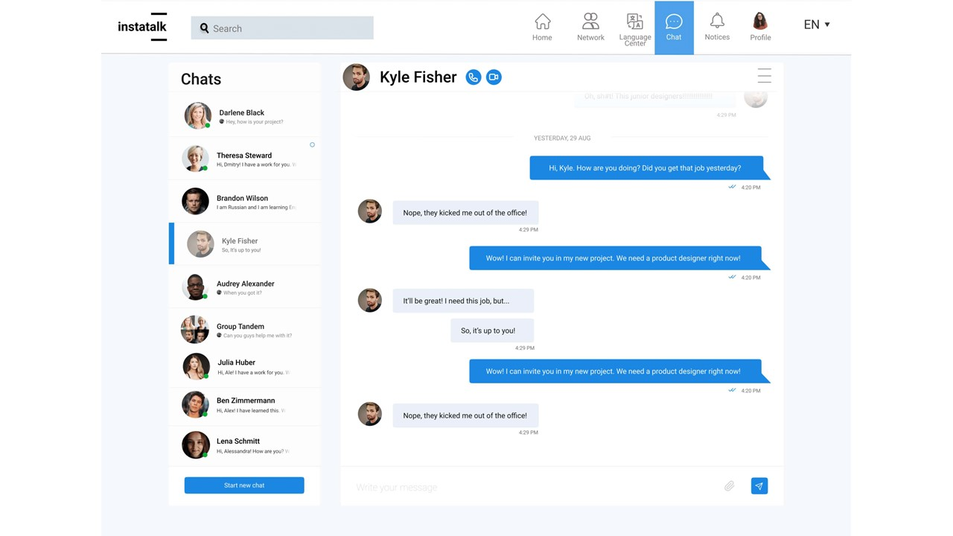

Slide 23
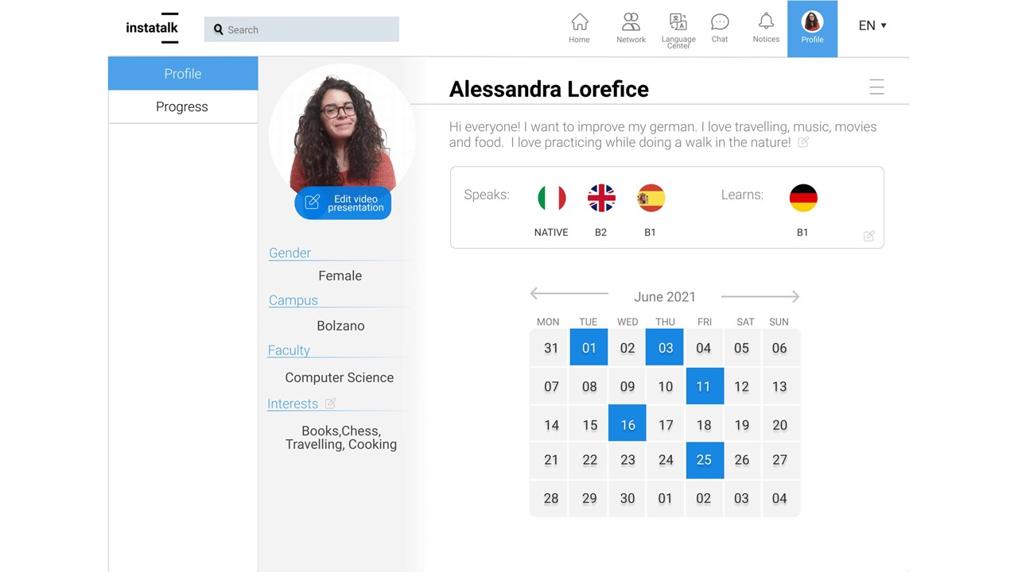

Slide 24
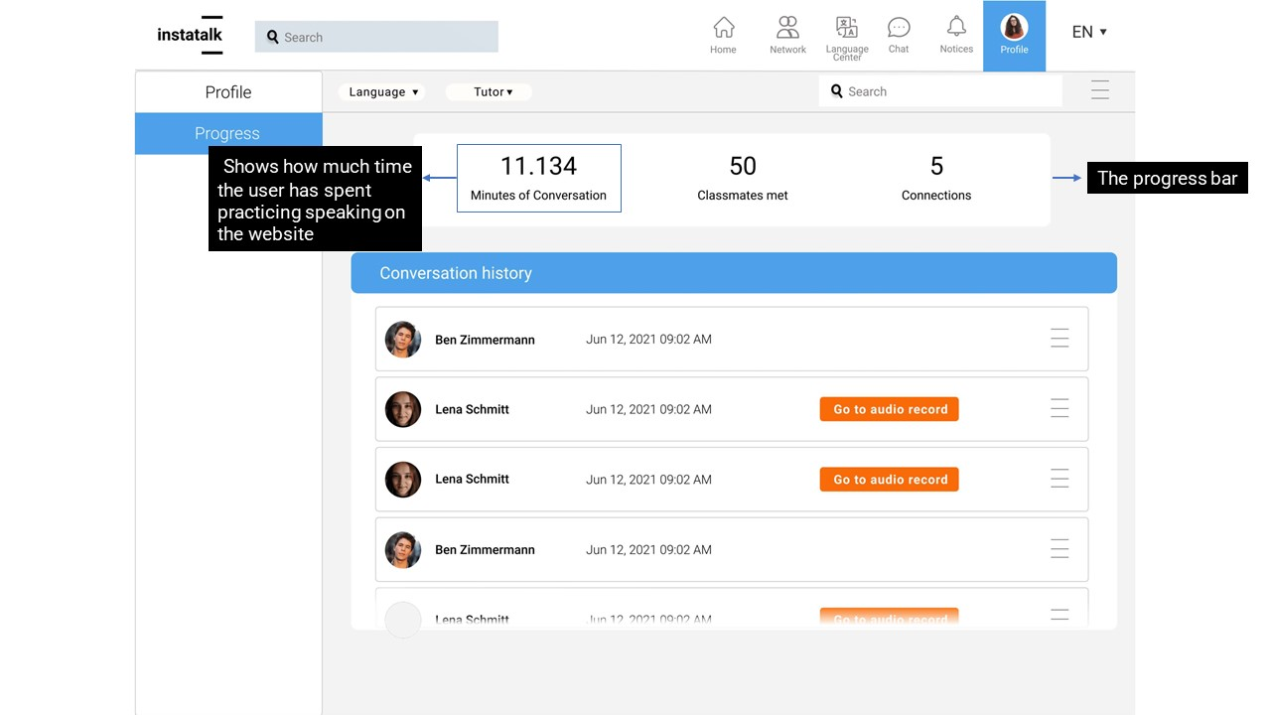

Slide 25
Index
Initial Problem
Prototyping
Evaluation
Conclusions

Slide 26
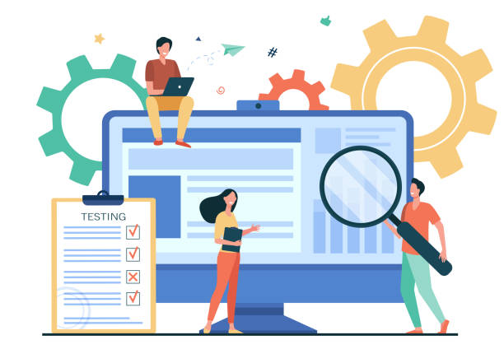
Methods
To evaluate the prototype, we interviewed two groups of people:
Users
Design students (to get feedback on the interface's design)

Slide 27
Results (1)
Learnability
Most users were able to understand the concepts and work with prototype easily
Effectiveness & Utility
We got positive feedback about the solutions for professionalism and matching problems
Safety
Users felt safe knowing the website is limited to unibz staff and the profiles are not fake

Slide 28
Results (2)
Discoverability
Users needed some explanation regarding some concepts such as tutor
Affordances
One user did not understand the meaning of different colors in the “Your network” section
Dissatisfaction
Some users saw the homepage as too crowded.
Some users did not like the idea of restricted chat and inability to change the profile's picture

Slide 29
Index
Initial Problem
Prototyping
Evaluation
Conclusions

Slide 30

Limitations
The potential activities were too broad
It was not possible to have feedback from all the potential primary users
A legal consultation about the consequences of report and block profile was needed
Lack of design skills

Slide 31
Conclusions
InstaTalk facilitates the process of finding a partner maintaining a professional environment
Limit social interactions can be a weakness if the trade-off is not reached
Restrict the website to unibz’s members increase the safety but reduce the number of potential users

Slide 32
Learning Outcomes
Users must be at the center of the design
Find a trade-off between users’ expectations and what is necessary for the system

Slide 33
Ethics
Inclusion and equality
tutor - option for users that can have difficulties to find partners.
Privacy
option for not being disturbed or receive messages/calls from others.
Safety and security
restricted by unibz members.

Slide 34

Future works
Building a fully interactive prototype
Designing a platform that connects more universities
Working on the issue of harassment in more depth
Take accessibility into account

Slide 35

Thank you for your attention!

